Slide 1
Hovercraft VDP 2
Group 13
Paul Longe
Bradley
Keqi
Divine
Xiang
Alex

Slide 2
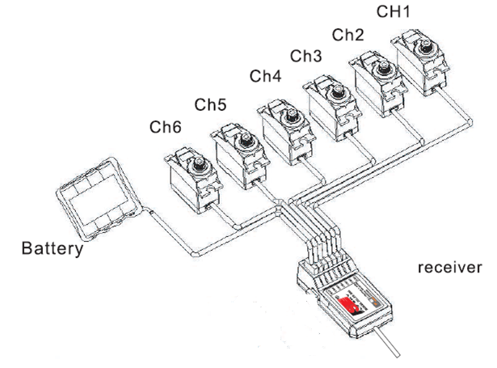
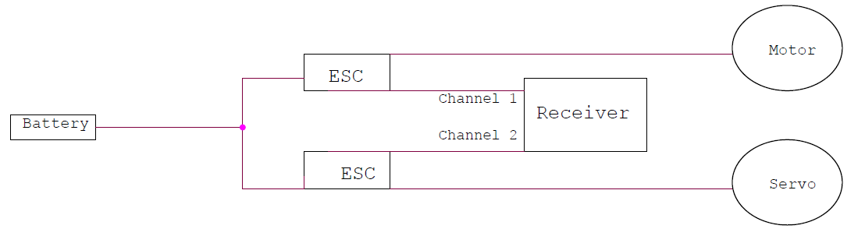
Circuits & ESC’s – Final Design
Divine Abraham - Electrical & Control Systems Engineer
What am I supposed to Control?
Lift
Speed
Direction
How Will I do it?
Battery connected to the ESC and ESC to Receiver.
Each channel of the receiver will be connected to an ESC.
ESC will be connected to the motors (fan) or a servo (rudder) that needs to change with user requirement.

